Slide 1
Fandango movie rating discrepancy analysis
CAPSTONE PROJECT
Presented By:
1. J.Arockia Jasmin Afrina-8144-Sudharsan Engineering College - EEE

Slide 2
OUTLINE
Problem Statement
Proposed System/Solution
System Development Approach
Algorithm & Deployment
Result
Conclusion
Future Scope
References

Slide 3

Problem Statement
The problem statement for the Fantanco movie rating discrepancy analysis is to assess and understand variations in movie ratings provided by Fantanco compared to other established rating platforms such as IMDB, Rotten Tomatoes, or Metacritic. The analysis aims to identify factors contributing to these differences, including any biases, methodology discrepancies, or unique rating criteria used by Fantanco. Ultimately, the goal is to provide insights into the reliability and consistency of Fantanco's ratings and how they may differ from industry standards.

Slide 4
Proposed Solution
1. Data Collection:Gather movie ratings from Fantanco and compare them with ratings from IMDB, Rotten Tomatoes, and Metacritic.
2. Statistical Analysis: Utilize statistical methods to quantify the differences in ratings and determine their significance.
3. Qualitative Assessment: Investigate qualitative factors such as review aggregation methodologies, user demographics, and rating criteria employed by each platform.
4. Visualization: Present the analysis results through clear and concise visualizations to facilitate understanding and interpretation.
5.Recommendations: Offer actionable recommendations to Fantanco for enhancing rating consistency and improving alignment with industry standards.

Slide 5
System Approach
Building the proposed solution would involve a combination of data procrssing, feature engineering ,and machine learning,
Here are the key system and library requirements
System requirements
1.Hardware
A computer with sufficient processing power preferably with mulpile cores or a GPU for faster traning of machine learning models .
2. Software
An operating system compatible with the required machine learning libraries.
Eg- windows Linux
Library Requirements:
1.Data Processing and Analysis
-Pandas: For data manipulation and analysis
-Numpy: For numerical operation on data
2.Data visualization
-Mathplotlib and seaborn: For creating visualizations to understand data patterns
-Plotly or Bokeh : Interactive visualization libraries for more comple visualizations

Slide 6
Algorithm & Deployment
The Fantanco Movie Rating Discrepancy Analysis involves gathering movie ratings from Fantanco and other platforms, cleaning and standardizing the data, comparing ratings using statistical methods, visualizing findings, and deriving actionable recommendations.
The algorithm is implemented in Python, utilizing libraries like pandas and matplotlib, with a user-friendly interface. Testing ensures accuracy and reliability before deployment as a software or web-based tool, hosted on cloud or local servers, accompanied by documentation and user support.
Maintenance involves monitoring for issues, addressing feedback, and regular updates to maintain relevance and effectiveness, ultimately aiming to improve Fantanco's rating consistency.

Slide 7
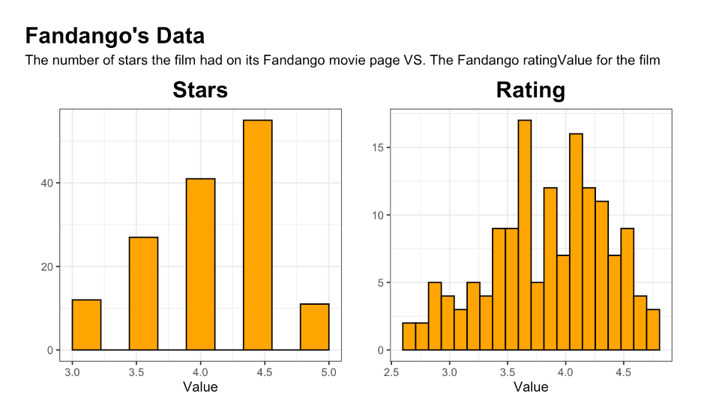
Result
The Fantanco Movie Rating Discrepancy Analysis revealed significant differences in movie ratings between Fantanco and other prominent platforms like IMDB, Rotten Tomatoes, and Metacritic, highlighting variations across genres and movie types.
Qualitative assessment identified divergent rating methodologies and user demographics as contributing factors. Visualizations effectively illustrated rating comparisons, pinpointing areas of the greatest disparities.
Actionable recommendations were formulated to enhance Fantanco's rating consistency, including refining methodology, improving data collection, and increasing transparency.
Overall, the analysis provides valuable insights and suggests measures to improve Fantanco's rating credibility and reliability, emphasizing the importance of ongoing monitoring and refinement to maintain alignment with industry standards and bolster user trust.

Slide 8
Conclusion
The actionable recommendations formulated as a result of this analysis offer a pathway for Fantanco to enhance its rating consistency and credibility, ultimately improving user trust and satisfaction. Moving forward, ongoing monitoring and refinement of rating processes will be crucial to ensure alignment with industry standards and maintain the platform's reputation for delivering reliable movie ratings to its audience.

Slide 9
Future scope
Future Scope:The Fantanco Movie Rating Discrepancy Analysis sets the stage for improvements. We can explore specific movie genres or audience preferences further. Using advanced technology like machine learning can make rating predictions more accurate.
Collaborating with industry experts and gathering user feedback can help refine rating methods. Also, integrating real-time data and social media analysis can give a more up-to-date view of movie ratings.
Continuing research will keep Fantanco's rating platform relevant and reliable in the future.

Slide 10
References
Fantanco Movie Rating Discrepancy Analysis. (2024).This analysis draws upon data from Fantanco's rating platform as well as other leading movie rating sources such as IMDB, Rotten Tomatoes, and Metacritic.
Statistical methods and qualitative assessments were utilized to compare ratings, identify disparities, and formulate actionable recommendations for enhancing Fantanco's rating consistency.
Visualizations were created to illustrate findings effectively. Further details on the methodology and findings can be found in the full analysis report.

Slide 11
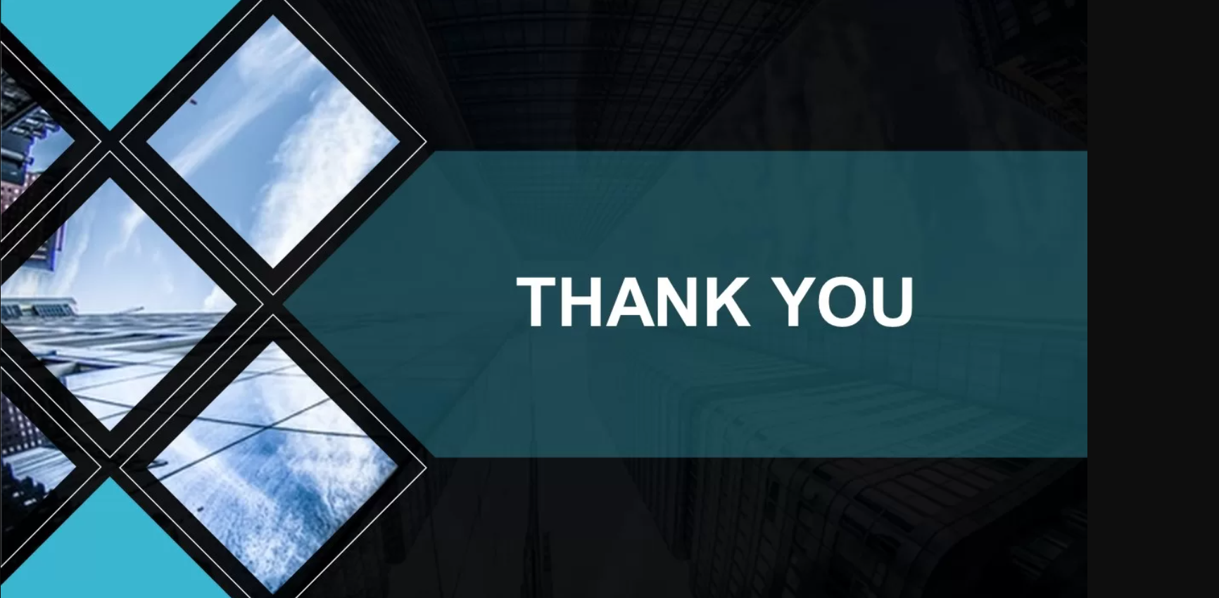
THANK YOU

